Slide 1
AIRLINE TRAFFIC - ETL PROCESS
Group 8 Project
Kelvin Nguyen, Matt Sufra, Raymond Chau, Anita Rynkanen

Slide 2
PROJECT OUTLINE
Two datasets were extracted from different data sources and Excel was used to explore the dataset
Datasets were retrieved into Jupyter Notebook for transformation with Pandas functions.
ERD was sketched and files were imported into a PostgreSQL database

Slide 3
DATA EXTRACTION
International Airlines, Operated Flights and Seats to and from Australia:
https://data.gov.au/data/dataset/international-airlines-airline-by-country-of-port-data/resource/809c77d8-fd68-4a2c-806f-c63d64e69842?view_id=c2e9db61-be01-4673-b83e-d8b7f5b9dd8e
Airline database:
https://www.kaggle.com/open-flights/airline-database?select=airlines.csv

Slide 4
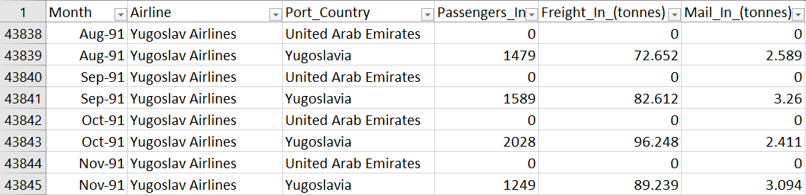
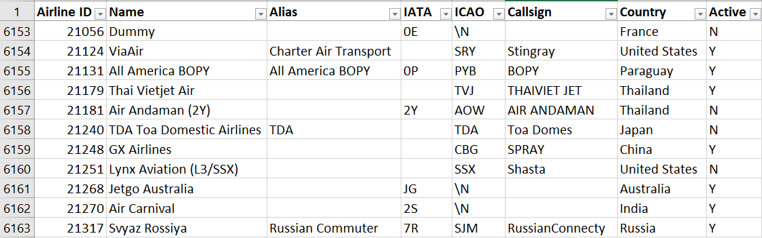
DATA EXPLORATION
Dataset 1
Dataset 2
Notes:
1st dataset contains about 43000 records with details of monthly air traffic information for each airline since 1985, it has porting countries, number of passengers, freight weight and mail weight in and out, but there’s no other information about airline other than airline name
2nd dataset has details of about 6000 airlines including airline ID, alias, country of origin and active status
So, assuming this airline data is complete, we will try to select only traffic data for airlines that are listed dataset 2,. As you can see, the two datasets share only one common column which is airline name. So we’re going to match these columns,
IATA: International Air Transport Association
ICAO: The International Civil Aviation Organization

Slide 5
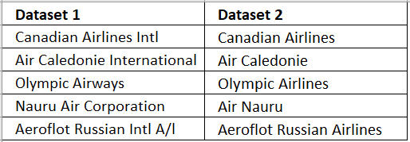
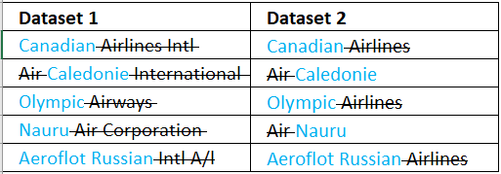
DATA EXPLORATION 1
Original data
Removing common words
Notes:
However, due to difference in name conventions, the result from merging the two tables was poor. For example… laser
The solution is to remove the common words for better matching

Slide 6
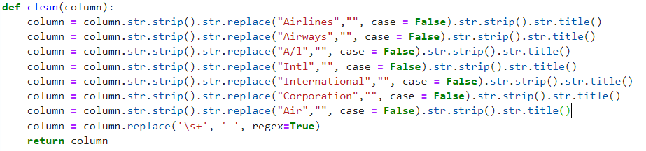
DATA TRANSFORMATION 1
Using predefined function to test clean data
Notes:
We developed a predefined function to replace the common words, LLL disregard case sensitive, trim the text, rewrite name in proper text format because some airlines have their name all in capital. Then finally replace multiple white space with a single space

Slide 7
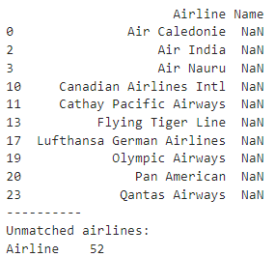
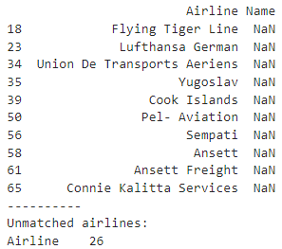
DATA TRANSFORMATION 1
Improvement of cleaning function
46 - 40 - 34 - 30 - 29
Notes:
After improving and retest the cleaning function, the unmatched airline names reduced by half from 52 to 26

Slide 8
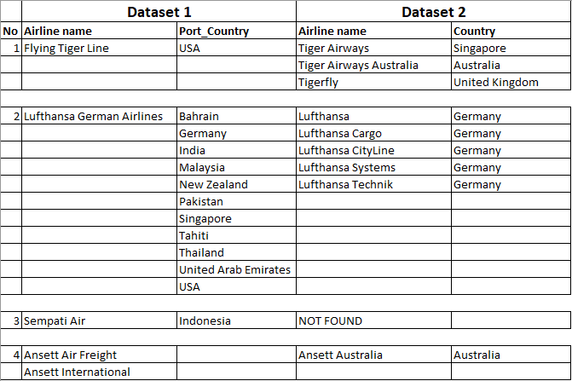
DATA TRANSFORMATION 1
Unmatched names:
Notes:
For those unmatched names, we randomly select airline names and compare between datasets.
Like Flying Tiger Line mainly operates in USA but when searching for tiger as a key word in dataset 2, there are three different airlines from countries other than USA
German airlines has 5 matching candidates
Indonesia Sempati airline not found
Ansett Air Freight and Ansett International could be the same under Ansett Australia
So we decided to drop the air traffic data for those 26 unmatched airlines

Slide 9
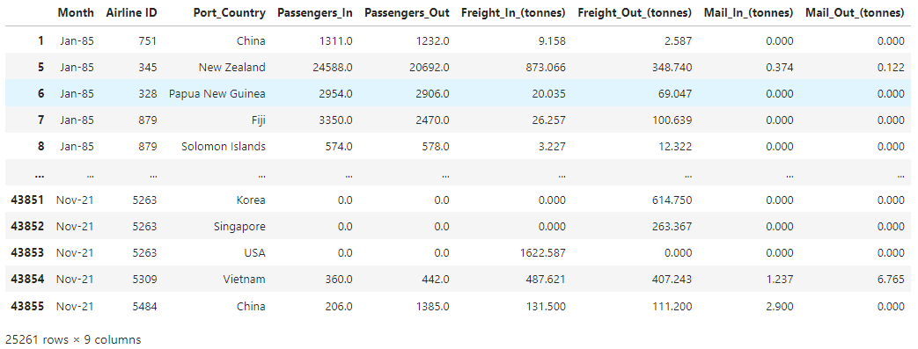
DATA TRANSFORMATION 1
Results:
Notes:
The final result is 25k records are usable. We removed the airline name column from the dataset 1 and use Airline ID to uniquely identify those airlines

Slide 10
DATA TRANSFORMATION 2
Imported > did a count to find missing values
Renamed columns to join with data set
Did unique count based on Airline column
Dropped duplicate Airlines
Re-indexed data frame
Dropped initial index column
Exported to a csv

Slide 11
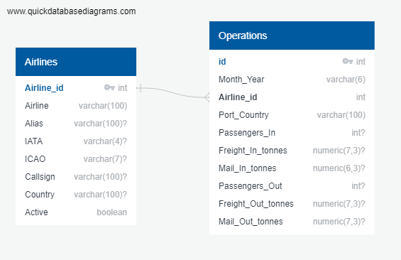
DATA LOADING
Relational Database created in PostgreSQL
Two tables, Airlines and Operations
Airline_id as Primary/Foreign key

Slide 12
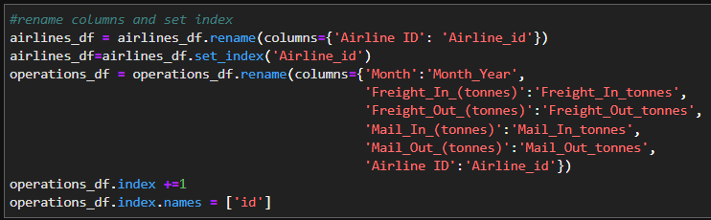
DATA LOADING
Columns and indexes changed to match format using Pandas
Python and SQLAlchemy used to load data into database

Slide 13
CONCLUSION
Comprehensive database on airlines and their operations
Analysis of flights between different countries
Comparison of different Airlines and find trends over 1985 to 2021

